Slide 1
Mapping the Modern Customer: A Business Case Exploration
Sungeun Kang (Kate), Clovis Ndang, Adebukola Aina, Suzana Mannan

Slide 2
BUSINESS UNDERSTANDING
HIGH LEVEL

Slide 3
Case Study
Business Case Studies UK
Identifying customers and meeting their needs

Slide 4
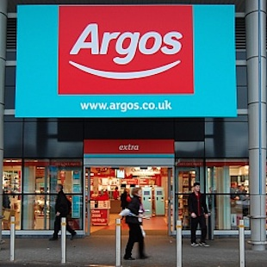
Introduction
Argos is the UK’s leading general merchandise retailer, known for its wide range of products and unique shopping experience. Operating over 580 stores, the UK population has an Argos store within a 10-mile radius of their home.
As consumer expectations shift toward faster, more convenient, and more digital shopping experiences, retailers like Argos are under pressure to adapt. In response, the company continuously evaluates customer needs, leverages technology to its advantage, and implements strategic growth initiatives to maintain its position at the top of the retail market.

Slide 5
Problem Solving Process
1 – Exploring the mess
# | Question | Answer
Q1.1 | What problems (or opportunities) did they face? | Argos faced growing competition and shifting consumer behaviors, exposing gaps in customer engagement and segmentation. However, it saw opportunities in expanding digital channels, targeting under-engaged customer groups, and leveraging its low-cost, multi-channel model to boost growth.
Q1.2 | Where was there a gap between the current situation and the desired one? | Argos’s ability to fully engage occasional or unaware customers, maximize purchase frequency, and effectively segment its market—shifting from demographic to behavior-based targeting to better meet evolving shopping preferences.
Q1.3 | What were the stated and unstated goals? | Stated Goals: To meet diverse customer needs through value, choice, and convenience. To grow the business through increasing frequency and spend per customer. To differentiate from competitors through a multi-channel experience. To leverage technology to make shopping easier and faster. Unstated Goals: To solidify Argos’ brand as a modern retailer that can compete with both physical and online-only retailers. To optimize operations behind the scenes (logistics, cost savings, stock visibility) to maintain profit margins while offering low prices.
Notes:
This step is complete when we have found and organized relevant information for the situation at hand and when we have made some initial hypotheses about the source of the problem and potential solutions.
Problem Solving Stage 1 – Exploring the mess: This initial step involved understanding the challenges Argos faced, such as growing competition and shifting consumer behaviors, and recognizing opportunities like expanding digital channel

Slide 6
Problem Solving Process
2 – Searching for information
# | Question | Answer
Q2.1 | What were the symptoms and causes? | Symptoms: Infrequent purchases from a significant portion of the customer base. Limited effectiveness of demographic segmentation. Causes: Outdated segmentation methods that didn’t reflect actual customer behavior. Growing competition and evolving consumer expectations around convenience and speed. Underutilization of digital tools among certain customer segments.
Q2.2 | What measures of effectiveness seemed appropriate? | Track customer engagement and spending Customer satisfaction and convenience ratings across shopping channels. Sales growth from both new and existing customers. Channel usage data (online, catalog, in-store, mobile).
Q2.3 | What actions were available? | Expand online and mobile shopping tools to improve accessibility and convenience. Increase product range and highlight value-for-money in marketing.
Notes:
This step is complete when we have found and organized relevant information for the situation at hand and when we have made some initial hypotheses about the source of the problem and potential solutions.
Problem Solving Stage 2 – Searching for information: In this stage, Argos identified symptoms like infrequent purchases and ineffective demographic segmentation, and considered measures such as tracking customer engagement and sales growth

Slide 7
Problem Solving Process
3 – Identifying a problem
# | Question | Answer
Q3.1 | Which was the most important problem in this situation? | Despite having a strong brand and multi-channel presence, it struggled to convert these customers and increase purchase frequency due to outdated shopping methods and evolving consumer expectations around convenience and technology.
Q3.2 | Was the problem like others they had dealt with? | Argos had experience adapting to customer needs through catalogues and store formats, but the shift in customer behavior toward digital and convenience-first shopping presented new challenges that required more advanced segmentation and multi-channel integration.
Q3.3 | What were the consequences of a broad versus narrow problem statement? | Some customers didn’t “get” what Argos offered, meaning the brand message wasn’t always clear or compelling. In result, a confusing or diluted brand image could weaken customer loyalty and trust.
Notes:
This step is complete when we have produced a working problem statement.
Problem Solving Stage 3 – Identifying a problem: The most important problem identified was Argos's struggle to convert customers and increase purchase frequency due to outdated shopping methods and evolving consumer expectations around convenience and technology

Slide 8
Problem Solving Process
4 – Searching for solutions
# | Question | Answer
Q4.1 | What decisions were open to them? | How to expand and integrate multi-channel shopping options, including online, catalog, in-store, and mobile. How much to invest in technology innovations like home delivery, kiosks, and quick-pay systems. Whether to focus on growing new customer segments or deepening loyalty among existing shoppers.
Q4.2 | What solutions had been tried in similar situations? | Expanding online and mobile channels was a common approach to meet modern consumer needs. Launching loyalty programs and personalized advertising to increase repeat purchases
Q4.3 | How did the various candidate solutions link to the outcomes of interest? | Multi-channel expansion improved convenience and accessibility, leading to higher customer satisfaction and sales. Technological innovations streamlined shopping and delivery, enhancing customer experience and loyalty.
Notes:
This step is complete when we have produced a list of potential solutions and perhaps a list of advantages and disadvantages for each one.
Problem Solving Stage 4 – Searching for solutions: This step involved exploring decisions like expanding and integrating multi-channel shopping options and investing in technology innovations such as home delivery and quick-pay systems

Slide 9
Problem Solving Process
5 – Evaluating solutions
# | Question | Answer
Q5.1 | How did the solution impact each of the criteria? | Sales Growth: Expanding multi-channel options and improving convenience led to increased sales and higher purchase frequency. Customer Satisfaction: Technology innovations like home delivery and quick-pay kiosks enhanced convenience, boosting satisfaction. Competitive Advantage: Differentiation through value, choice, and convenience strengthened Argos’s position against rivals.
Q5.2 | What factors within their control could have improved the outcomes? | Faster adoption and integration of new technology across all shopping channels. Enhanced staff training to ensure consistent customer service. Continuous innovation in product range and delivery options.
Q5.3 | What factors outside their control could have altered the outcomes? | Competitive actions by other retailers, including pricing and technology adoption. Technological infrastructure limitations or disruptions (e.g., internet outages). Macroeconomic events like recessions or pandemics influencing retail foot traffic and online shopping trends.
Notes:
This step is complete when we have produced a recommended course of action, along with justification that supports it.
Problem Solving stage 5 – Evaluating solutions: Solutions were evaluated based on their impact on criteria such as sales growth, customer satisfaction, and competitive advantage, with technological innovations enhancing convenience and boosting satisfaction

Slide 10
Problem Solving Process
6 – Implementing a solution
# | Question | Answer
Q6.1 | What were the barriers to successful implementation? | Resistance to change: Moving from traditional demographic segmentation to behavior-based methods required shifts in mindset and processes. Technology adoption challenges: Integrating new digital channels and tools needed investments and staff training. Customer adaptation: Some customers, especially less tech-savvy ones, might resist changing their shopping habits.
Q6.2 | Where was there support and motivation, or resistance and conflict? | Resistance & conflict: Possible internal hesitation toward adopting new technologies or processes. Some customers resistant to shifting away from traditional catalog or in-store shopping.
Q6.3 | Were there resources available for successful implementation? | No direct resources was mentioned in the study that was provided for Argos.
Notes:
This step is complete when we have produced an implementation plan and executed enough of it to begin evaluating how well it is succeeding.
Problem Solving Stage 6 – Implementing a solution: Key barriers to successful implementation included resistance to changing from traditional segmentation to behavior-based methods, technology adoption challenges, and customer adaptation issues

Slide 11
DATA UNDERSTANDING
HIGH LEVEL

Slide 12
Conceptual Model
ARGOS GROWTH STRATEGY
Opening new stores
Increasing product range
Expanding website
Maintaining customer loyalty
Tv and other media advertising
SEGMENTS
Non frequent customers (“don’t quite get-its”)
Frequent customers (“get its)
ARGOS
ARGOS EDGE
Value for money
Convenience
Proximity
SHOPPING CHANNEL
In store
Online
Telephone

Slide 13
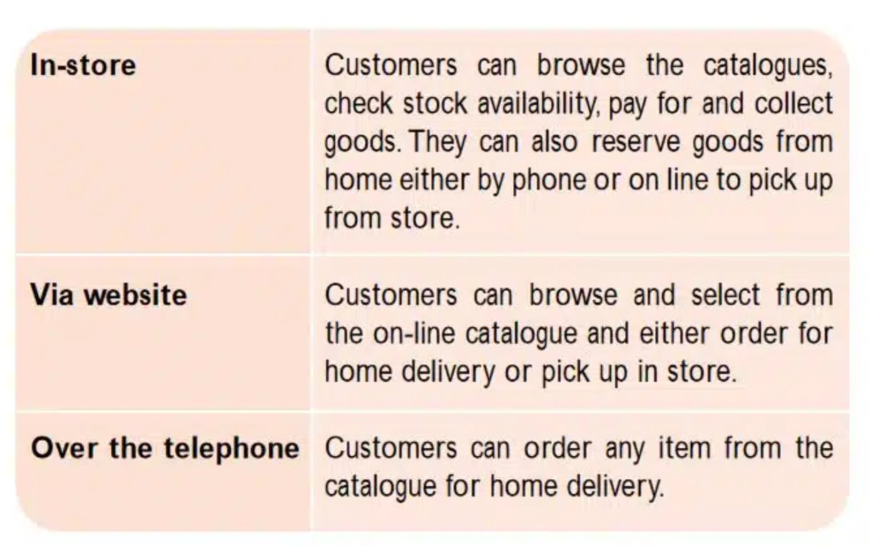
Data Dictionary

Slide 14
BUSINESS UNDERSTANDING
LOW LEVEL

Slide 15
What are the monthly trends in online and in-store sales for 2021, and how do they project forward based on assumed growth?
Business Question

Slide 16
DATA UNDERSTANDING
LOW LEVEL

Slide 17

Data Set 1
Retail Sales and Customer Behavior

Slide 18
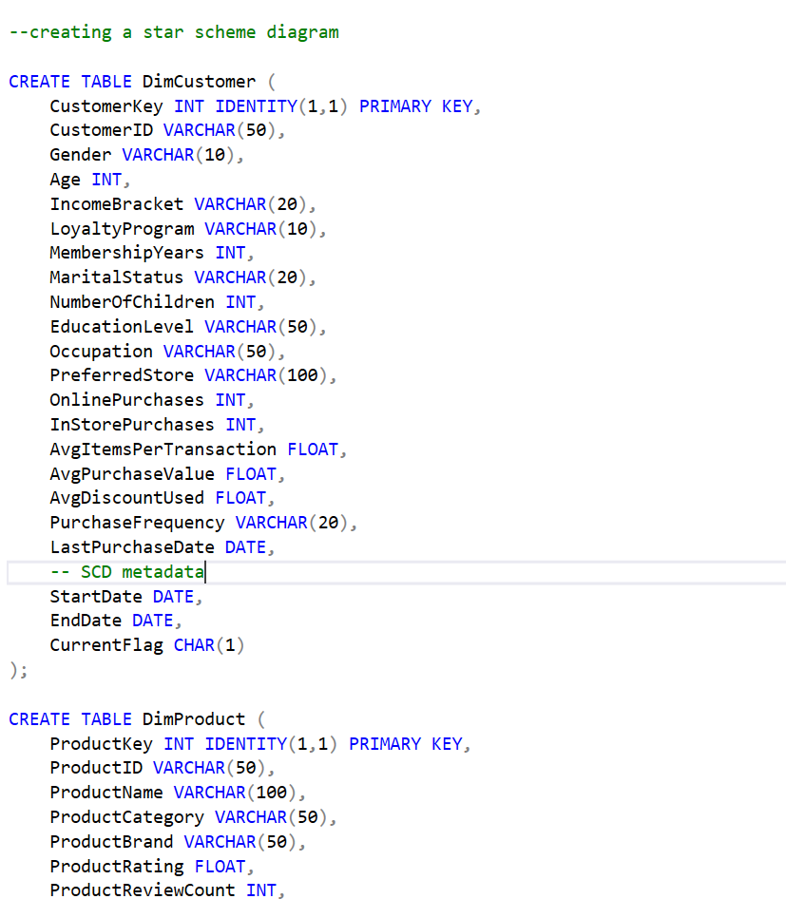
Dataset 1
The original dataset was provided as a flat table. Using SQL, we transformed it into a star schema by creating related dimension and fact tables. This structure allows for proper relational modeling and supports efficient querying and analysis in Power BI.

Slide 19
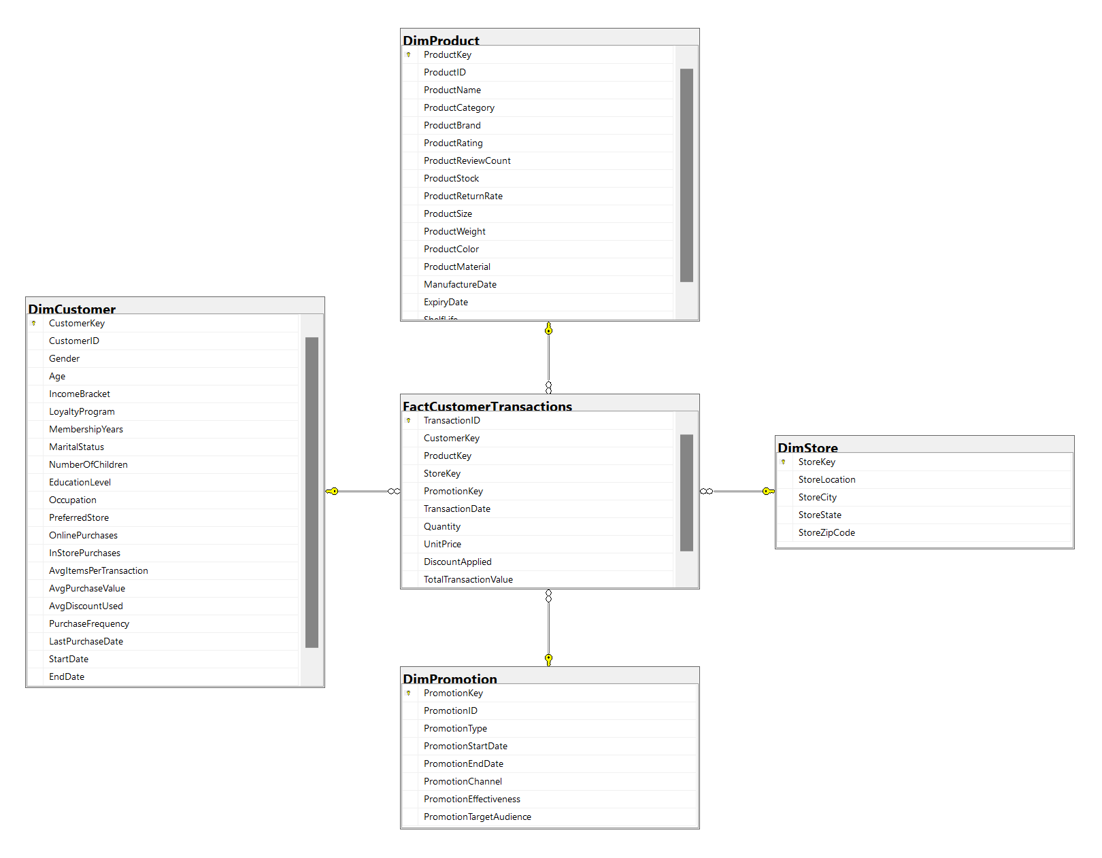
Database Diagram 1 (SQL)

Slide 20
DATA PREPARATION

Slide 21
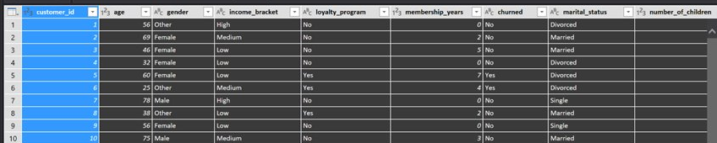
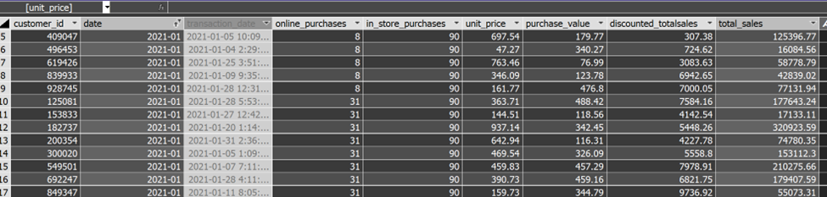
Q1. DATA CLEANSING
ORIGINAL
Standardized the Transaction Date column to (YYYY-MM)
Removed or filtered out transactions with NULL or zero total sales
Segmented customers by purchase behavior by Online and In-Store
Renamed columns (Friendly Names) to improve clarity
Reorganized columns visually for easier development navigation.
Created the following measures using AutoSum (DAX) inside the model
EDITED

Slide 22
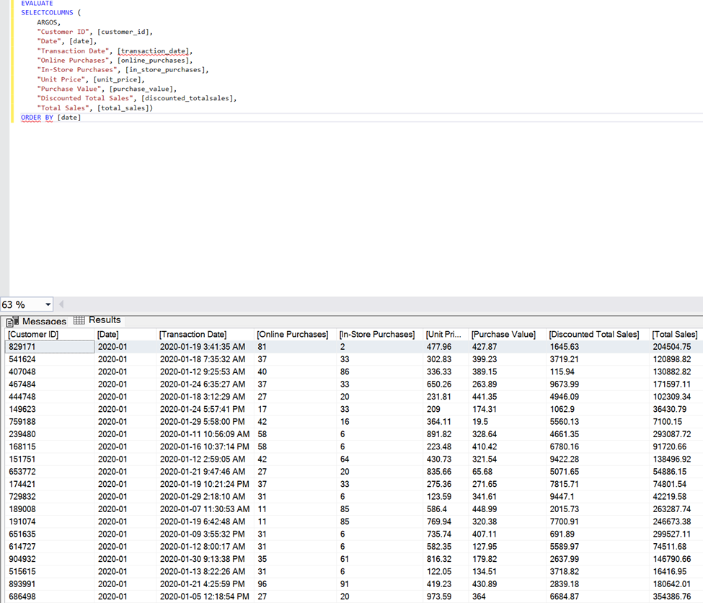
Q1. DATA CLEANSING
Data cleansing and semantic modeling were carried out in Visual Studio within the model.bim file. The processed model was then deployed to SQL Server Analysis Services (SSAS), enabling access to the data through DAX.

Slide 23
PREDICTIVE ANALYSIS
AND MODELING

Slide 24
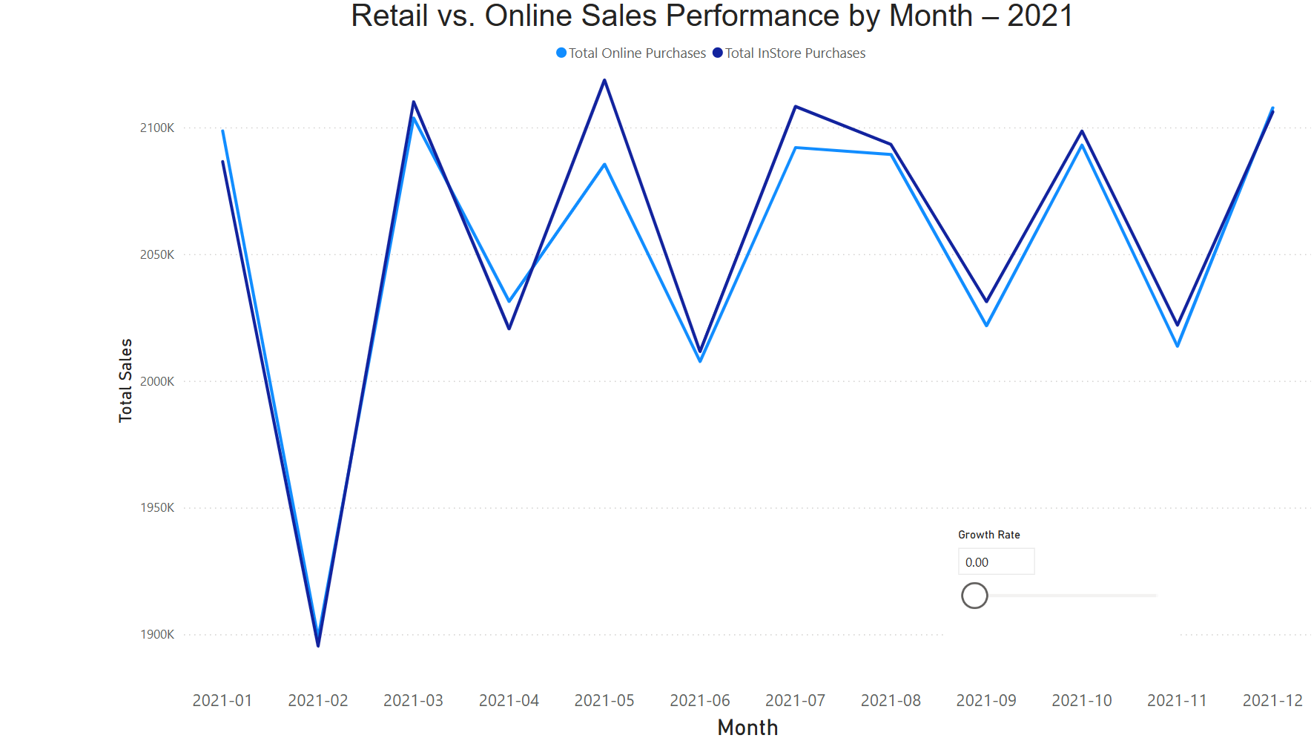
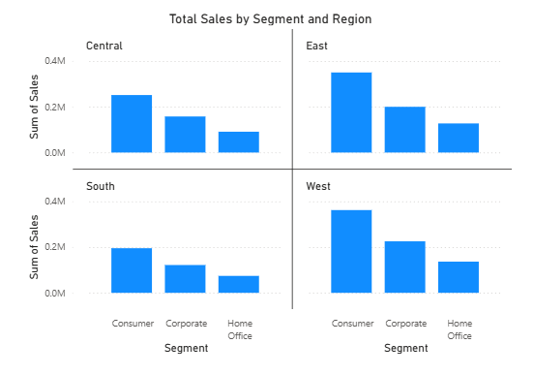
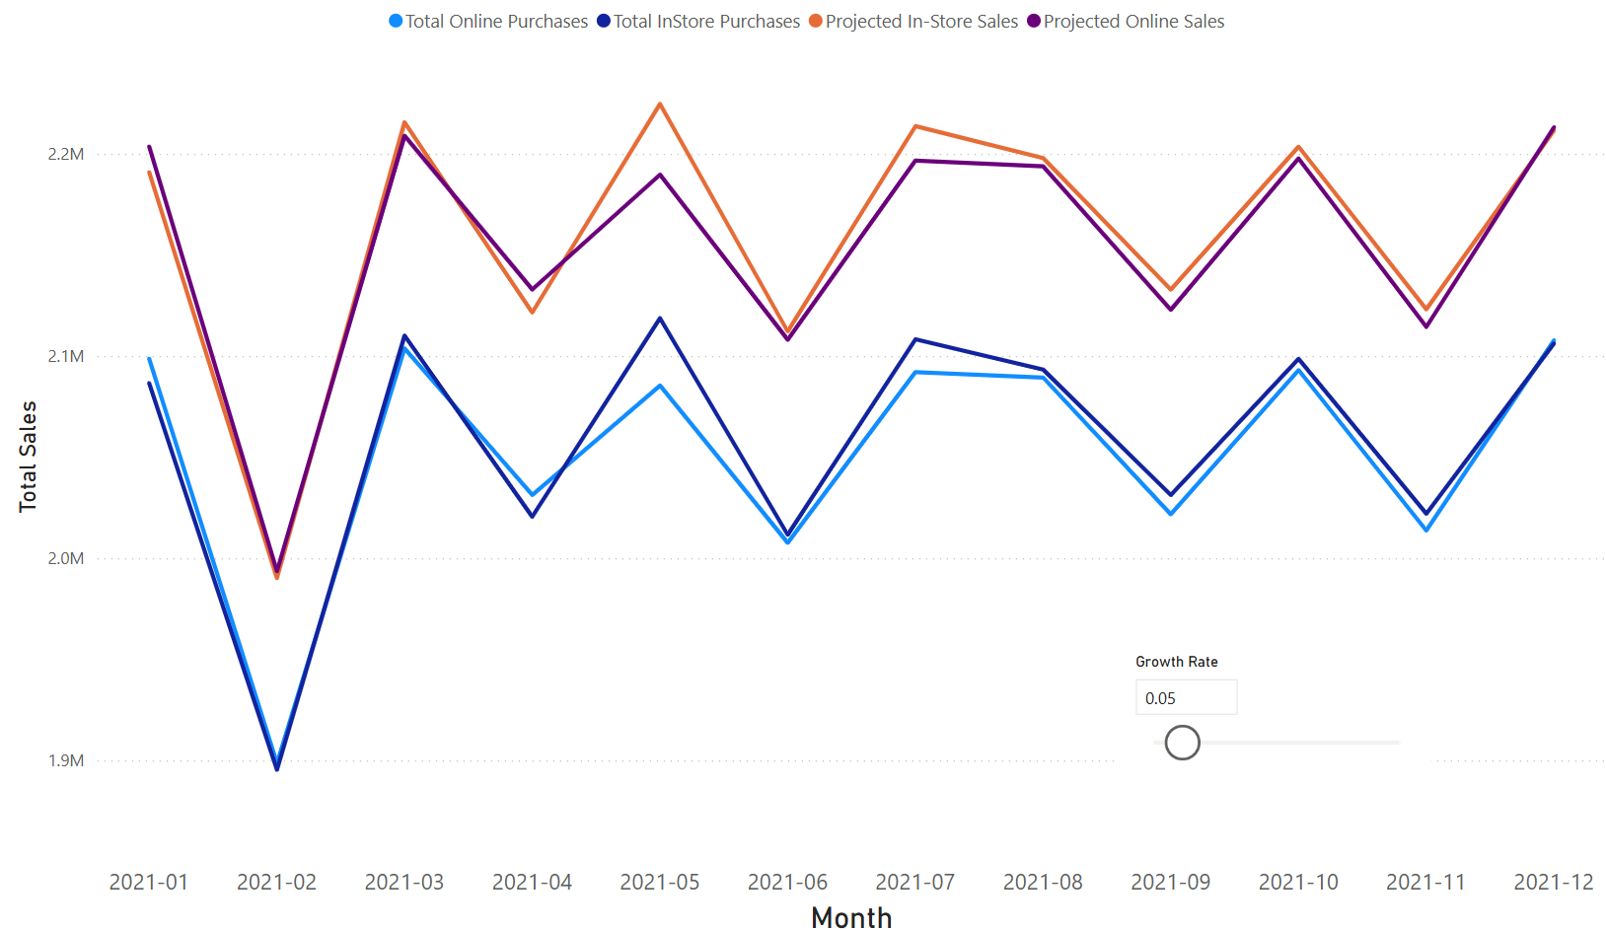
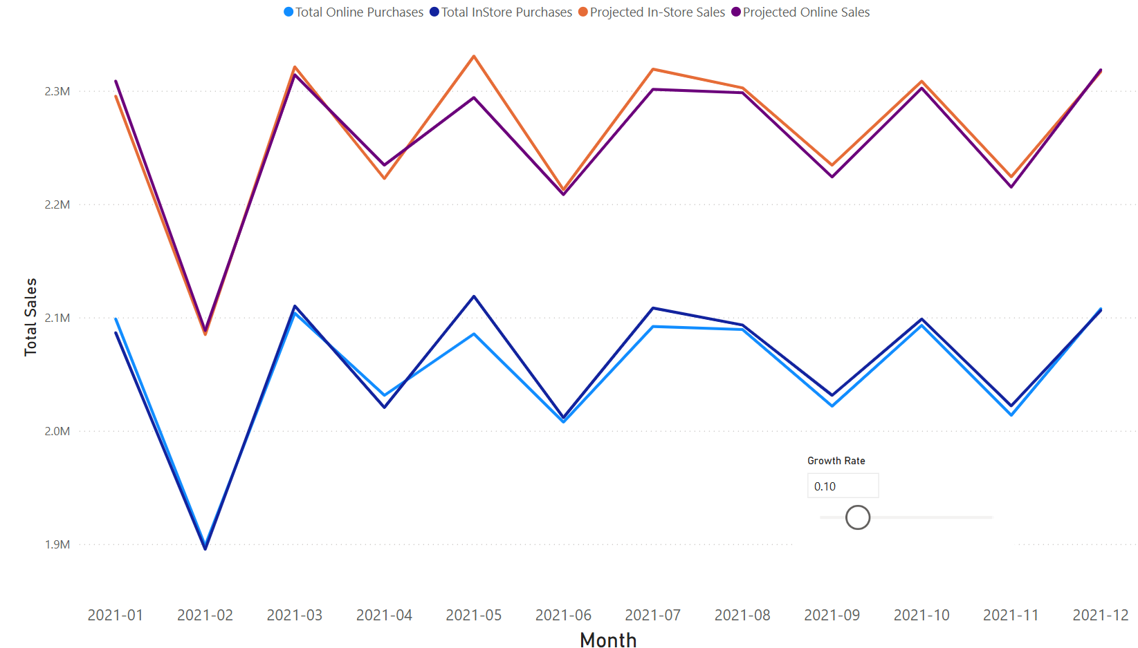
Dashboard
Diagram

Slide 25
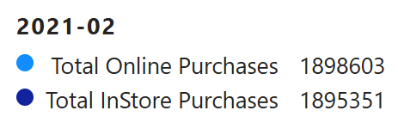
Visualization: Question 1
The total monthly sales for online and in-store purchases throughout 2021. It reveals consistent trends and seasonal fluctuations across both channels, with similar peaks and dips. The graph establishes a historical baseline that will be used to generate projected sales based on adjustable growth rates. The growth rate parameter (shown below) allows us to simulate future scenarios and explore how small changes could impact total sales performance.

Slide 26

Predictive Analysis: Question 1
(Parameter)
The "parameter" supports what-if analysis, helping decision-makers understand the potential impact of varying growth scenarios over time. The growth rate parameter allows users to simulate projected sales by applying a percentage increase to each month’s historical sales.
Growth Rate: 5%
Projects moderate growth based on current trends — a conservative forecast.
Growth Rate: 10%
Simulates stronger performance, possibly reflecting post-COVID recovery, new marketing strategies, or expanded customer reach.

Slide 27
EVALUATION

Slide 28
Conclusion: Answer to Question 1
Both in-store and online sales followed similar monthly trends in 2021, suggesting shared seasonal influences (e.g., promotions, holidays).
In-store sales consistently outperformed online sales, indicating a stronger customer preference or operational presence in physical retail.
The gap between the two channels remained narrow throughout the year, highlighting the importance of maintaining a balanced omnichannel strategy.
When a projected growth rate (e.g., 5% or 10%) is applied, both channels show proportional increases, with peak months seeing the highest projected gains.
This suggests that future growth is likely to scale with existing sales patterns, reinforcing the value of using historical data for forecasting.

Slide 29
BUSINESS UNDERSTANDING
LOW LEVEL

Slide 30
2. Which customer segment is generating the highest sales revenue in each region, and how is that trend changing monthly?
Business Question

Slide 31
DATA UNDERSTANDING
LOW LEVEL

Slide 32
Data Set 2
Superstore Dataset

Slide 33
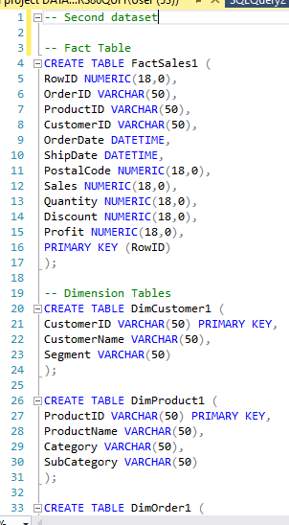
Dataset 2
The original dataset was provided as a flat table. Using SQL, we transformed it into a star schema by creating related dimension and fact tables. This structure allows for proper relational modeling and supports efficient querying and analysis in Power BI.

Slide 34
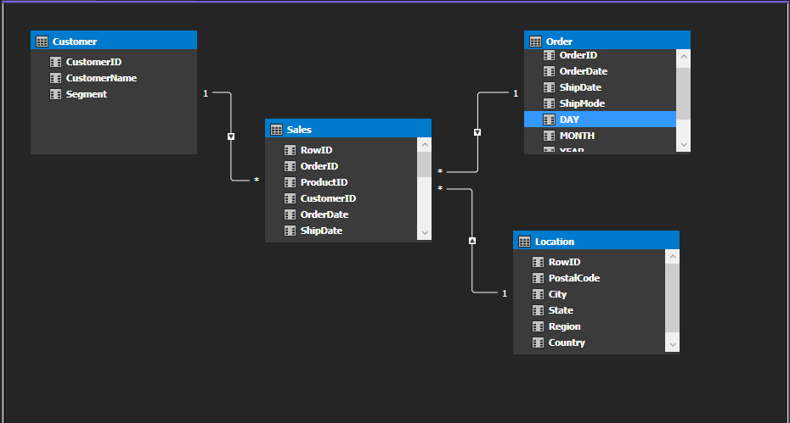
Database Diagram 2 (Visual Studio)

Slide 35
DATA PREPARATION

Slide 36
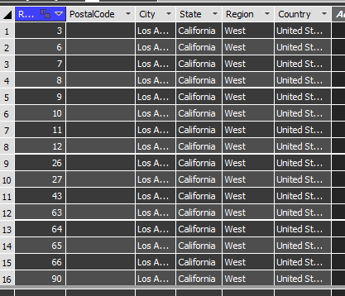
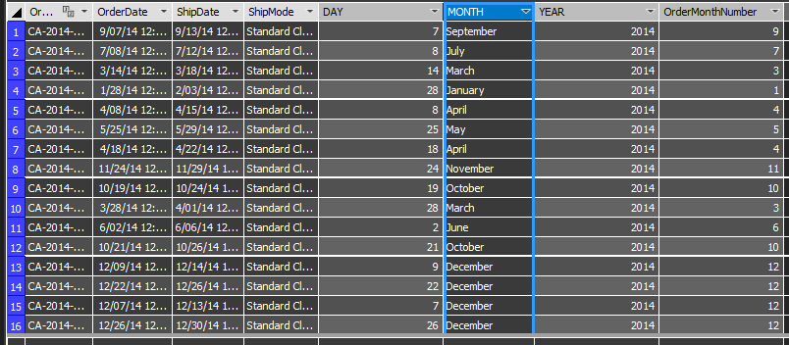
Q2. DATA CLEANSING
Location
Order Date
Three new columns were created to extract and separate the original OrderDate column into individual components: Day, Month, and Year.
The City, State, Region, and Country fields were organized in a hierarchical order, allowing all related entries (e.g., all records for Los Angeles, then all for Dallas, etc.) to be grouped together.

Slide 37
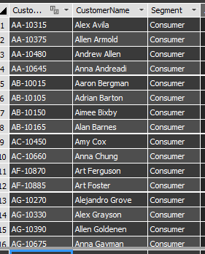
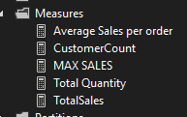

Q2. DATA CLEANSING
Customer Name
Measures
Several new DAX measures were created to enhance data analysis capabilities:
Total Sales – Calculates the total revenue generated from all orders.
Total Quantity – Sums the total quantity of items sold.
Average Sales per Order – Computes the average revenue per individual order.
Customer Count – Counts the number of unique customers.
Max Sales – Identifies the highest sales value from a single order.
The First Name and Last Name fields were sorted in alphabetical order.

Slide 38
PREDICTIVE ANALYSIS
AND MODELING

Slide 39
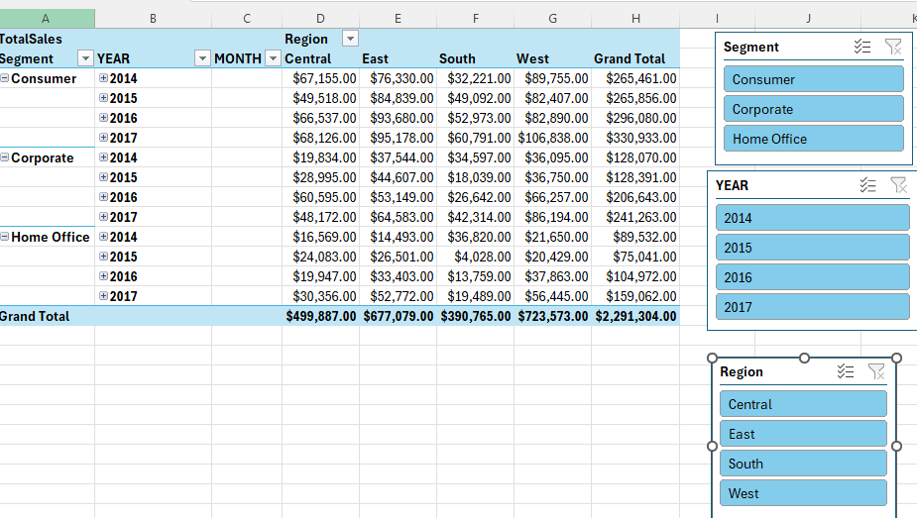
Pivot Table
Pivot Table was built to summarize and analyze total sales data by segment, year, and region, making it easier to understand performance patterns and support data-driven decisions quickly and efficiently.

Slide 40
Visualization: Question 2

Slide 41
EVALUATION

Slide 42
Conclusion: Answer to Question 2
Based on the Sales Data Analysis, the Consumer segment emerged as the top performing segment across all regions, generating the highest total revenue.
This indicates a strong demand from individual consumers, making this segment a key driver of business performance.
This trend was consistent across the years, indicating a stable engagement and purchasing behavior from this group.
As a result, a targeted marketing and retention strategy aimed at this segment could further enhance revenue growth.

Slide 43
5W 1H Analysis
1 – Who
1- Who
# | Question | Answer
Q1.1 | Who is involved? | The primary parties involved are Argos as a retailer, its marketing and strategy teams, and consumers who engage through its in-store, catalogue, and digital channels. Also involved are suppliers, technology partners, and Argos employees who support sales and service.
Q1.2 | Who is affected? | Argos, customers and competitors
Q1.3 | Who will benefit? | Frequent customers (the “Get its”) benefit from better service and expanded product options. Infrequent customers (the “Don’t quite get its”) benefit through tailored promotions and improved convenience. Argos benefits from higher loyalty, increased sales, and growth from both new and retained customers.
Q1.4 | Who will be harmed? | Competitors may lose market share as Argos improves customer engagement. Infrequent customers may feel overwhelmed or left behind if Argos overemphasizes digital tools and underinvests in traditional channels. Employees in non-digital roles might face pressure or redundancy as operations digitize.
Notes:
The questions on this slide are sourced from this article:
https://premium.wpmudev.org/blog/a-simple-sure-fire-way-to-create-great-content-the-5-w-the-h/
Who is involved?
Who is affected?
Who will benefit?
Who will be harmed?

Slide 44
2- What
# | Question | Answer
Q2.1 | What is your topic narrowed down in a simple phrase/sentence? | Improving customer retention by understanding shopping behavior at Argos.
Q2.2 | What does your topic involve? (i.e. What are the different parts to it?) | Customer segmentation by shopping frequency Multi-channel retail strategies (store, catalogue, online) Marketing campaigns targeting different shopper types Technology use for convenience (e.g., Quick Pay, home delivery) Value-focused pricing and customer satisfaction
Q2.3 | What is it similar to / different from? | Similar to: Other retail loyalty strategies like those used by Amazon or Walmart Different from: Traditional high-street retailers who rely heavily on in-store display and less on catalogs or home delivery models
Q2.4 | What might be affected/changed by your topic? | Customer loyalty and purchase frequency Sales growth and basket size Employee training and roles Competitor positioning in the retail market
Notes:
The questions on this slide are sourced from this article:
https://premium.wpmudev.org/blog/a-simple-sure-fire-way-to-create-great-content-the-5-w-the-h/
What is your topic narrowed down in a simple phrase/sentence?
What does your topic involve? (i.e. What are the different parts to it?)
What is it similar to / different from?
What might be affected/changed by your topic?

Slide 45
3- When
# | Question | Answer
Q3.1 | When does this take place? When did this take place? When will it take place? When should this take place? | This takes place continually, as customer behavior and market trends evolve. The strategic shift began in the early 2000s, with major growth reported between 2003 and 2004, and has continued since. It will continue into the future as Argos expands digital channels and adapts to changing customer needs. Customer segmentation, marketing, and tech-driven service should be ongoing—regular updates are necessary to stay competitive in retail.
Q3.2 | Does when this takes place affect the topic? | Yes. Timing is critical because consumer preferences shift rapidly. Implementing strategies early helps Argos stay ahead of competitors and meet evolving customer expectations.
Notes:
The questions on this slide are sourced from this article:
https://premium.wpmudev.org/blog/a-simple-sure-fire-way-to-create-great-content-the-5-w-the-h/
When does this take place? When did this take place? When will it take place? When should this take place?
Does when this takes place affect the topic?

Slide 46
4- Where
# | Question | Answer
Q4.1 | Where does this take place? (Where did it …. Where will it … Where should it ….?) | This takes place across the UK and the Republic of Ireland, through Argos stores, catalogues, and digital platforms.
Q4.2 | Does it matter where it takes place? Is it affected by location? | Yes. Location affects: Customer accessibility (98% live within 10 miles of a store) Preferred shopping channels (urban vs rural shoppers may differ) Delivery options and logistics costs
Notes:
The questions on this slide are sourced from this article:
https://premium.wpmudev.org/blog/a-simple-sure-fire-way-to-create-great-content-the-5-w-the-h/
Where does this take place? (Where did it …. Where will it … Where should it ….?)
Does it matter where it takes place? Is it affected by location?

Slide 47
5- Why
# | Question | Answer
Q5.1 | Why is this topic important? Why does it matter? | Understanding and meeting customer needs is crucial for business growth, retention, and competitiveness. For Argos, improving shopping convenience and value is essential to keep customers loyal in a crowded retail market. It matters because customer behavior is changing rapidly with the rise of online shopping.
Q5.2 | Why do certain things happen? (What are some causes and effects within the topic?) | Cause: Customers prefer convenience and speed Infrequent shoppers don't fully understand the value offered Loyal customers are familiar and satisfiied with Argos Rising competition in retail Effect: Argos invest in quick Pay kiosks and home delivery Marketing is used to increase awareness and drive repeat visits Strategy focuses on increasing basket size with them Argos differentiates through multi-channel access and pricing More customers shop online or check stock via mobile and SMS
Notes:
The questions on this slide are sourced from this article:
https://premium.wpmudev.org/blog/a-simple-sure-fire-way-to-create-great-content-the-5-w-the-h/
Why is this topic important? Why does it matter?
Why do certain things happen? (What are some causes and effects within the topic?)

Slide 48
5W 1H Analysis
6 – How
6 - How
# | Question | Answer
Q6.1 | How does this topic work? How does it function? How does it do what it does? | Argos functions by offering a multi-channel retail model that includes catalogues, physical stores, online shopping, and mobile access. It analyzes customer behavior, particularly shopping frequency, to tailor promotions and improve loyalty. It works by combining low operating costs, broad product variety, and technological convenience to meet modern consumer demands.
Q6.2 | How did it come to be? | The model evolved over time: Started as a catalogue-based retailer in 1973 Grew into a national chain with over 580 stores Expanded into digital platforms in response to customer needs and market competition Invested in technologies and home delivery to stay relevant and accessible
Q6.3 | How are those involved affected? | Consumers-Experience more convenience, better value, and faster service Employees-Must adapt to tech-driven tools and customer service innovation Argos-Gains competitive advantage and increased sales through personalized strategies Competitors-Lose market share if they cannot match Argos'value, convenience, or tech innovation
Notes:
The questions on this slide are sourced from this article:
https://premium.wpmudev.org/blog/a-simple-sure-fire-way-to-create-great-content-the-5-w-the-h/
How does this topic work? How does it function? How does it do what it does?
How did it come to be?
How are those involved affected?

Slide 49
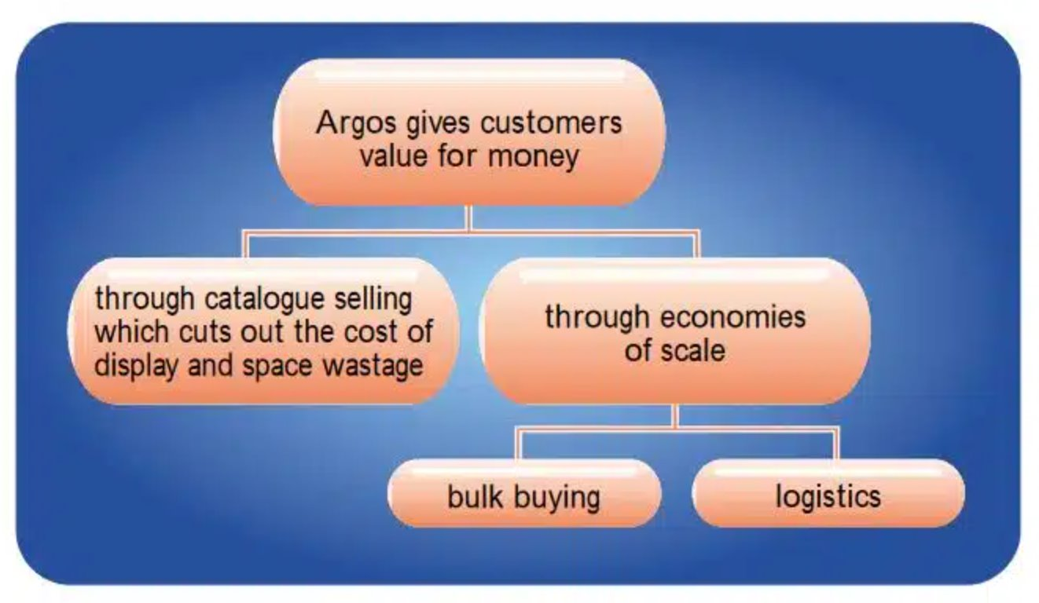
Conceptual Model

Slide 50
Solution Evaluation
The "Get its"
The "Don't quite get its"
Argos’s growth strategy focuses on increasing shopping frequency and basket size per customer.
Targets a loyal customer segment known as “The Get Its.”
Argos expanded its product range to encourage cross-category shopping.
Emphasis was placed on shopping speed, identified as a top priority for customers.
The strategy is based on the idea that greater variety and convenience lead to larger purchases per visit.
Argos uses broad advertising and multi-channel convenience to engage less familiar customers, called “The Don’t Quite Get Its.”
Television and media campaigns promote awareness of Argos’s product range and value for money.
Offers multiple shopping channels: in-store, catalogue, online, phone, SMS updates, and Quick Pay kiosks.
Aims to meet diverse customer preferences and shopping habits.
Strategy helps convert passive or occasional shoppers into active buyers by reducing friction and increasing brand familiarity.
Notes:
Solution
To address the challenge of driving business growth in a competitive retail environment, Argos has adopted a customer-focused growth strategy. The company believes that increasing both the frequency of customer visits and the average basket size per transaction is key to achieving this goal. By tailoring solutions to different customer segments those already loyal to the brand and those who are less engagedArgos aims to boost sales, deepen customer relationships, and enhance overall shopping experience. The following sections explore two targeted strategies designed to support this growth objective.
The “Get Its”
Argos's growth strategy targets increased shopping frequency and basket size per customer, particularly among its loyal base referred to as “The Get Its.” These are customers who already understand and value the Argos proposition, such as its convenience, affordability, and product range. To appeal further to this group, Argos introduced an ever-expanding product range, enhancing cross-category shopping. They also focused on convenience for customers based on the findings that customers regard speed to be top criterion when making shopping decisions. This strategy is underpinned by the understanding that a wider selection and faster shopping increases the likelihood of customers purchasing more in a single visit, thereby increasing average order value.
The “Don’t Quite Get Its”
Argos uses a solution that combines broad advertising with multi-channel convenience to bridge the gap. Television and media campaigns are designed to raise awareness about Argos’s extensive product range and value for money. Simultaneously, the company’s multi-channel retail strategy offers flexible shopping methods including in-store browsing, catalogue ordering, online purchasing, phone orders, SMS updates, and Quick Pay kiosks, to accommodate diverse customer preferences. This approach is crucial in converting passive or occasional shoppers into active buyers by removing friction and building familiarity.

Slide 51
Solution Evaluation
Multi-channel retailing strategy
Customer segmentation and targeting
Value of Money
Increase customer base
&
Boost loyalty
Customer feedback integration
Effective supply chain management
Technological integration and innovation
Notes:
1. Customer Segmentation and Targeting
Argos uses market research and customer data to segment its audience based on shopping behavior, preferences, and specific needs. This segmentation enables the company to design personalized services and product offerings for different customer groups. From a business analytics standpoint, this approach strengthens targeting and customer engagement by aligning products with what each group values most. By analyzing survey results and purchase data, Argos can identify patterns that help improve customer satisfaction and loyalty. While effective, this could be further enhanced by using advanced segmentation techniques like clustering.
2. Multi-channel Retailing Strategy
To meet the varying preferences of its customers, Argos has implemented a multi-channel retailing strategy. Customers can shop in-store, via catalogues, online, through telephone orders, by receiving text updates, or by using Quick Pay kiosks. This approach not only improves convenience but also allows Argos to collect data across multiple touchpoints. Each channel interaction provides insights into customer behavior, which can be analyzed to refine marketing and service delivery.
3. Focus on Value for Money
Argos emphasizes offering value for money, product variety, and convenience. The company stocks a broad range of items at competitive prices, supported by efficient logistics and bulk purchasing strategies. These efforts help reduce costs, allowing the company to pass savings onto customers. Argos’s low-cost product display system also supports this strategy by minimizing overhead. This solution is well-aligned with customer needs.
4. Customer Feedback Integration
Argos collects feedback from various customer interactions and uses it to guide improvements in products and services. This continuous loop of collecting and acting on customer input ensures that offerings stay relevant and customer-focused. It allows Argos to respond to complaints, identify product issues, and enhance service features.
5. Technological Integration and Innovation
Argos has embraced technology to streamline customer service and enhance convenience. Quick Pay kiosks allow faster transactions in-store, while SMS alerts notify customers when their orders are ready. Additionally, a strong online platform supports e-commerce and order tracking. These innovations improve the customer experience and reduce service bottlenecks.
6. Efficient Inventory and Supply Chain Management
The company operates centralized warehouses and uses real-time inventory systems to ensure that products are available and deliveries are timely. This strategy reduces operating costs and improves efficiency across the supply chain.

Slide 52
Recommendation
Use predictive modeling (advanced segmentation techniques like clustering) to further enhance their segmentation and targeting beyond two segments. This will boost customer satisfaction via improved personalization.
Aligning Inventory with Local Demand:
Sales analysis by season and region using time series forecasting (using past data to predict the future), they can figure out what products will likely be in demand and when.
To limit supply shortage, stock-pilling and maintain appropriate inventory levels across the board
Optimize digital experience with AI-powered personalization (e.g., recommended products).
Introduce a loyalty scoring system to reward “Get its” and encourage higher-value purchases.
All of this makes shopping with Argos feel more reliable, both online and in-store because customers know what they want is likely in available.

